Slide 1
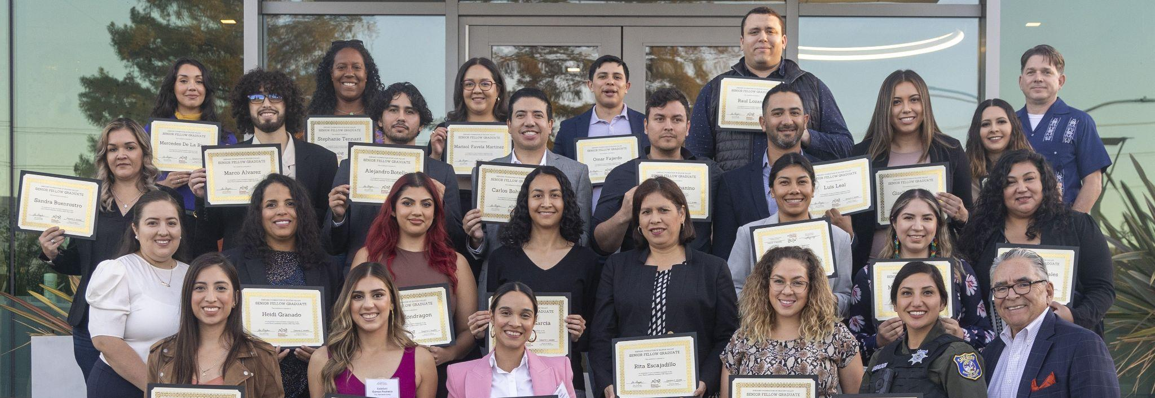
LATINO BOARD LEADERSHIP ACADEMY
Class XXIV

Slide 2
LATINO BOARD LEADERSHIP ACADEMY April 12, 2023
6:00 – 6:15 PM | Program Orientation – Ron Gonzales
6:15 – 6:30 PM | Getting to Know Each Other – Everyone
6:30 – 6:50 PM | HFSV Introduction
6:50 - 7:00 PM | Break
7:00 – 7:20 PM | Status of Silicon Valley Latinos – Small Group Discussions
7:20 – 8:00 PM | Small Group Report Backs
8:00 PM | Adjourn

Slide 3
LATINO BOARD LEADERSHIP ACADEMY Funders
LatinXCEL Fund

Slide 4
LATINO BOARD LEADERSHIP ACADEMY Partners

Slide 5
LATINO BOARD LEADERSHIP ACADEMY Protocols
Academy Locations | Hybrid!
In-Person Sessions
Zoom Meetings
Academy Expectations
No more than 1 absence!
Please let us know when you will be absent
Attendance will be taken at 5:30 p.m.
Must use your video on Zoom
Mandatory - Please fill out a short
session evaluation after each class

Slide 6
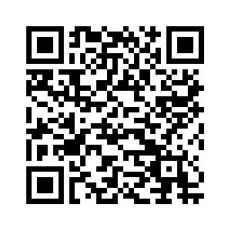
LATINO BOARD LEADERSHIP ACADEMY Protocols
LBLA Webpage
Weekly assignments, announcements and updates will be posted.
The link was emailed to you, please bookmark it or scan the QR code.

Slide 7
SESSION | DATE | FORMAT
LBLA Orientation + Introductions | Wed, April 12, | In-Person | San Jose, CA
Board Roles + Responsibilities | Wed, April 19 | Virtual
History of Silicon Valley’s Nonprofit Sector | Wed, April 26 | Virtual
Financial Responsibilities | Wed, May 3 | Virtual
Boards in Action | Wed, May 10 | Virtual
Choosing the Perfect Nonprofit LBLA Alumni Panel | Tues, May 16 | Virtual
The Board’s Role in Organizational Sustainability | Tues, May 23 | Virtual
Fundraising Responsibilities | Wed, May 31 | Virtual
Personal Branding | Sat, June 3*** | In-Person | U.C. Santa Cruz Silicon Valley Campus
Board Match Night | Wed, June 7 | In-Person | U.C. Santa Cruz Silicon Valley Campus
LBLA Graduation! | Wed, June 14 | In-Person | Location TBD

Slide 8
STAY CONNECTED!

Slide 9
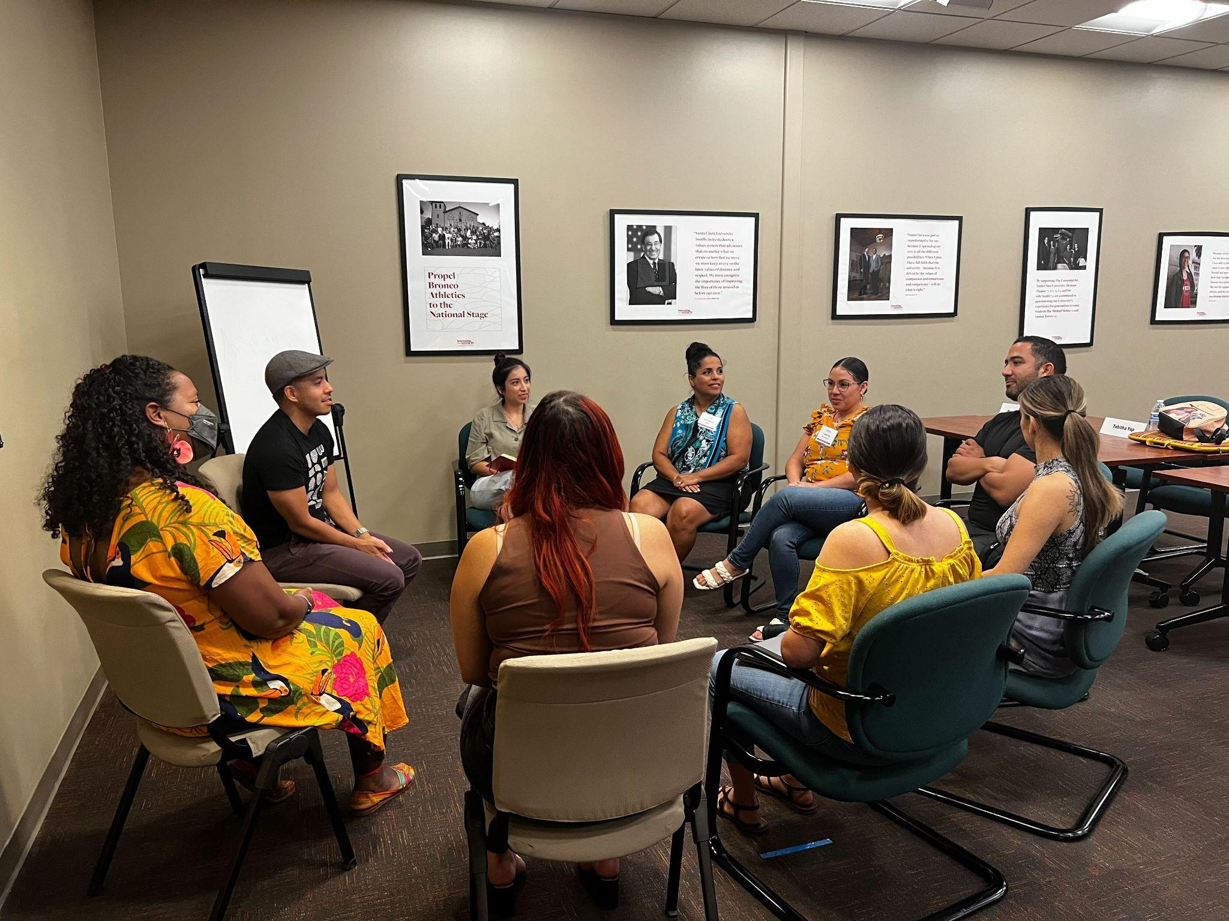
LATINO BOARD LEADERSHIP ACADEMY
Icebreaker
Getting to Know Each Other
Name
Employer
Title
Birthplace
College Attended
Major
Favorite Hobby

Slide 10
LATINO BOARD LEADERSHIP ACADEMY Announcements
Latino Report Card Convening
June 13, 2023
Computer History Museum
LBLA/LITSI Mixers
TBD: 2-3 Events
Playground Global Tour/Mixer
April 27th | 2 - 6pm
Palo Alto, CA
34th Hispanic Foundation Ball
Saturday, October 21, 2023
Downtown San Jose | Signia by Hilton

Slide 14
Our Mission
We are a public foundation dedicated to inspiring community philanthropy and engaging people to invest in the educational achievement and leadership development, convening and engaging a thriving Latino community in Silicon Valley.
Our Vision
The Hispanic Foundation of Silicon Valley is the recognized leader in Hispanic philanthropy in Silicon Valley, inspiring Latino families and children to achieve personal greatness.

Slide 15
The HFSV Team

Slide 16
3 PRIORITY AREAS
Education
Excellence
Leadership Development
Convening & Engaging
‹#›

Slide 17
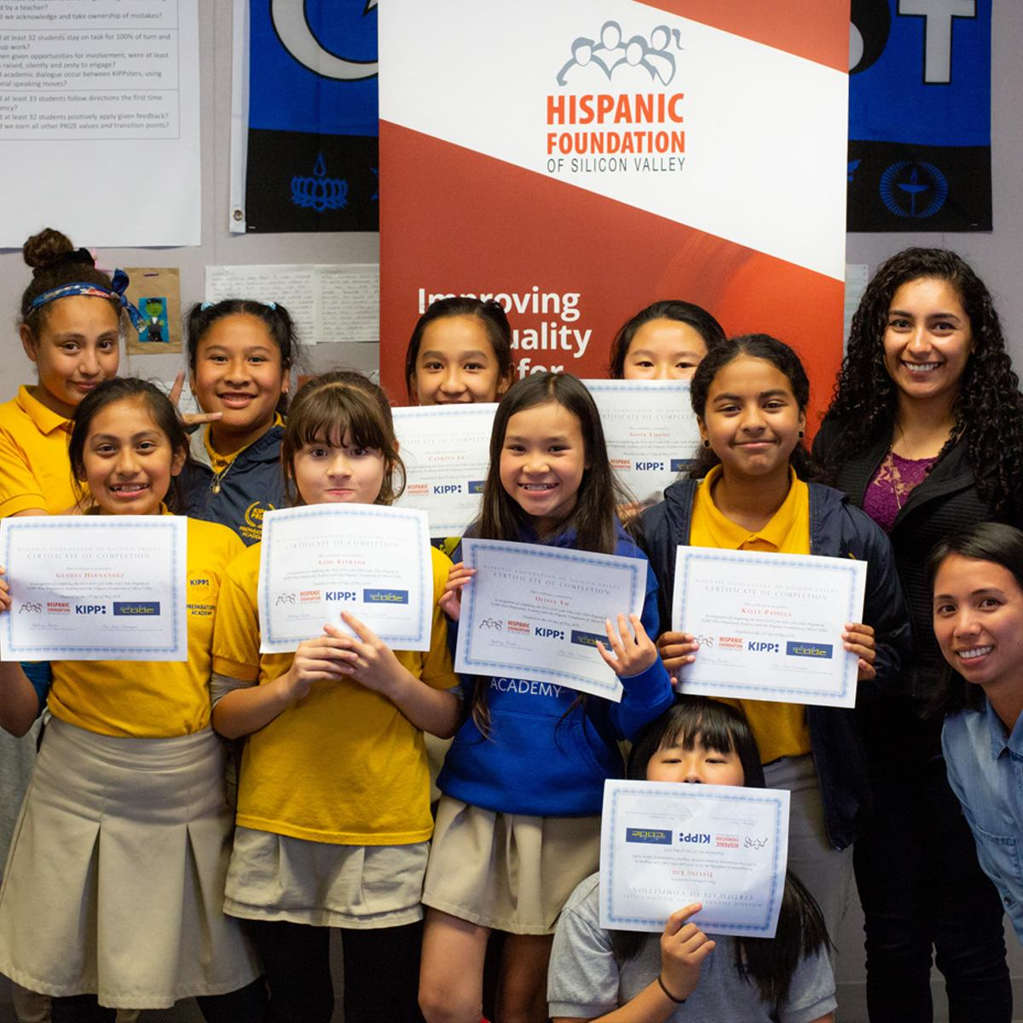
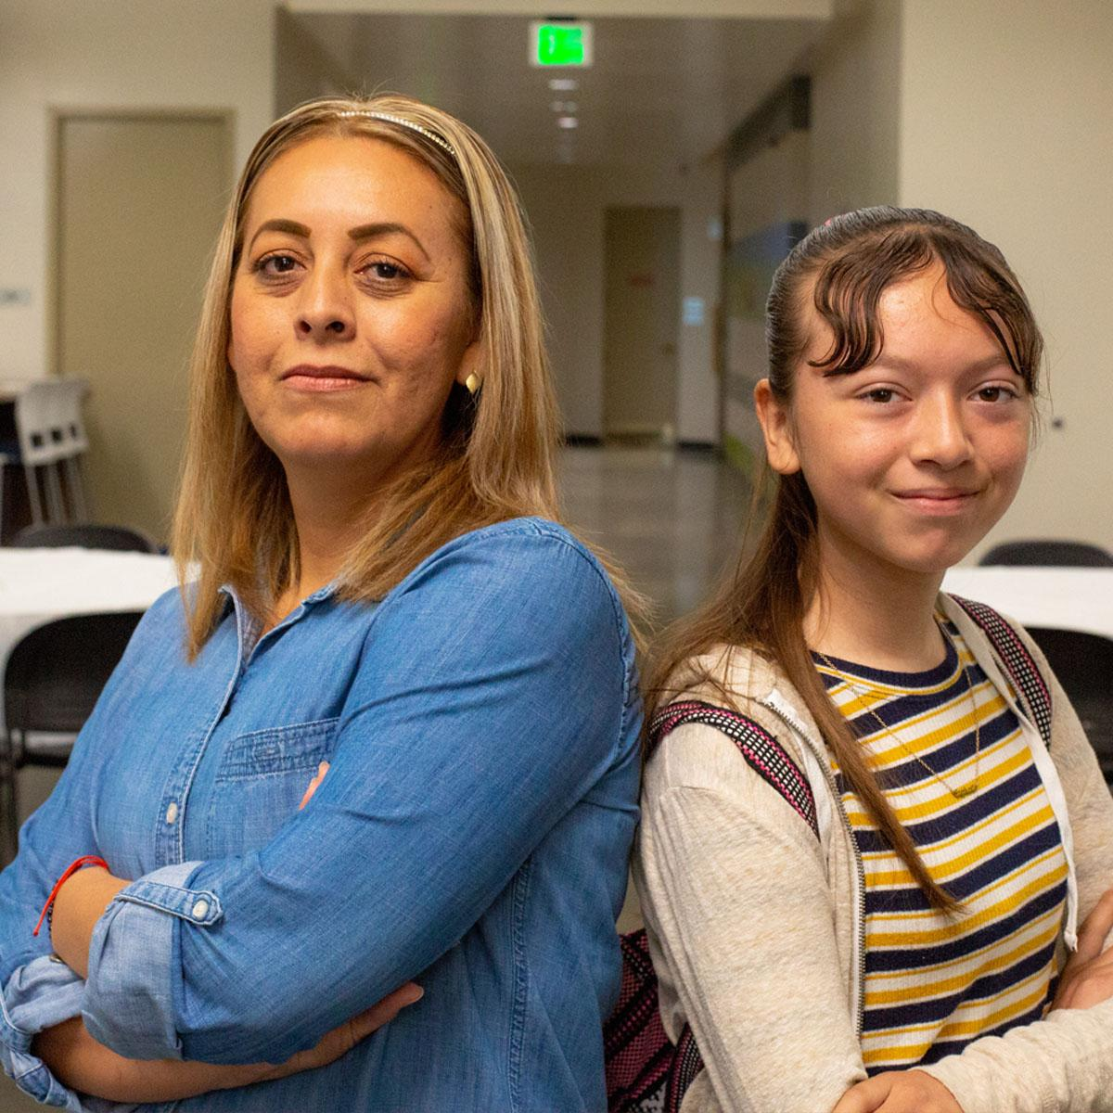
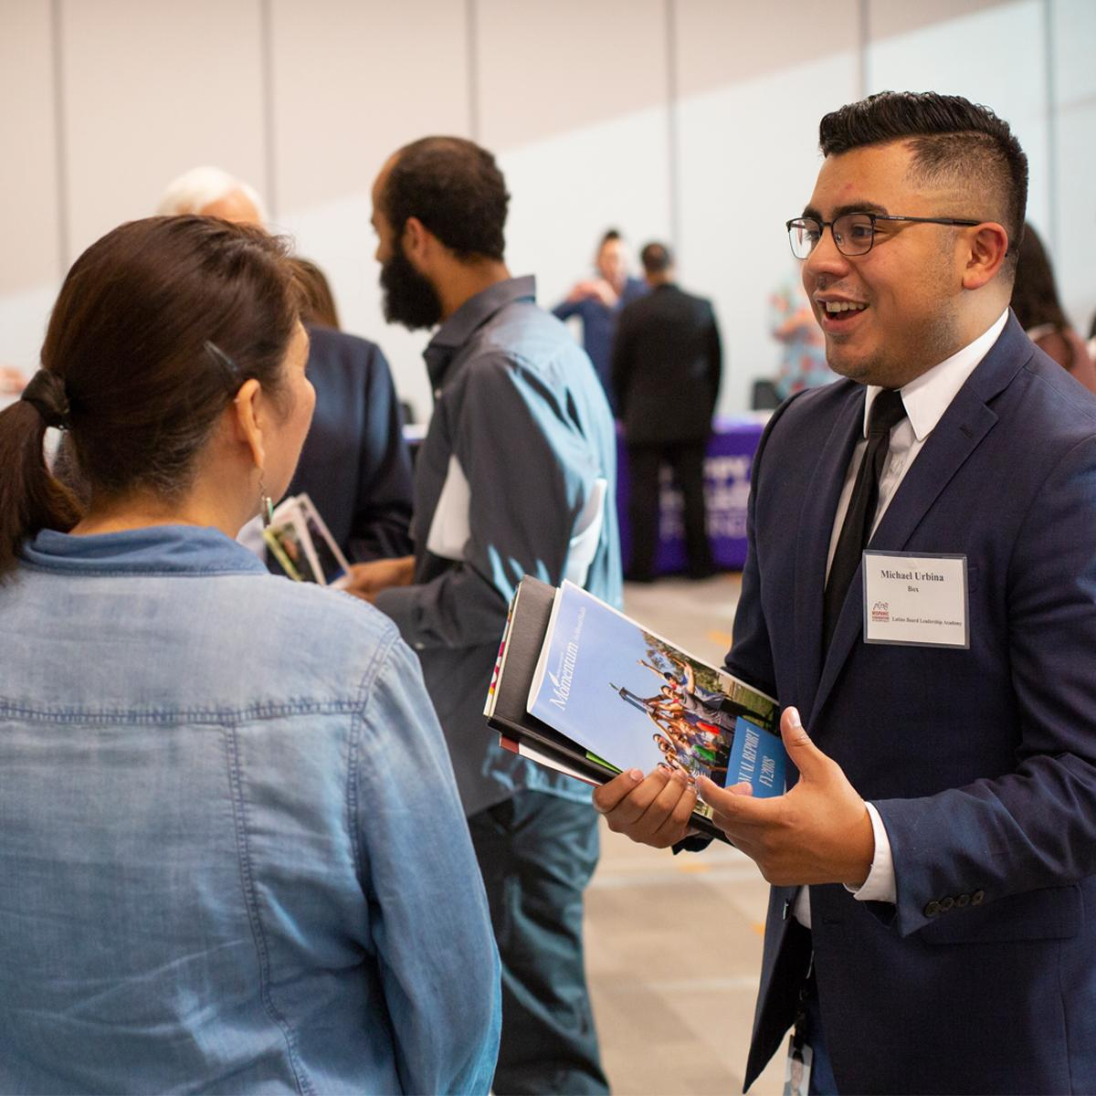
INITIATIVES AND PROGRAMS
Education Excellence | Latinos in Technology Initiative
Hispanic Foundation College Success Program (HFCSP)
College-readiness, STEM-related classes and other resources serving close to 2,100+ Latinx students and parents annually.
Latinos in Technology Scholarship (LITS)
Scholarship support renewable for up to three years for Latinx college juniors and seniors majoring in STEM
Scholars receive professional development resources, mentorship opportunities, + internship support
479 scholars to date
Excel
Lead
The Latino Board Leadership Academy
Trains Latinos on how to be successful board members of nonprofit organizations.
600+ graduated fellows to date.
Connect
The Hispanic Foundation Ball. | October 21, 2023
The Latino Report Card | research about the quality of life of Latinos in Silicon Valley
Latinx Speaker Series | a platform for Latinx leaders to convene and address issues.

Slide 18
Current Program Offerings

Slide 19
LEADERSHIP DEVELOPMENT
Graduated over 600+ Senior Fellows
70% Nonprofit Board Placement
LBLA Fellows elected to public office
Partners:
Center for Excellence in Nonprofits
University of California, Santa Cruz
SVCN!
Individual Presenters

Slide 20
CONVENING & ENGAGING
THE LATINO COMMUNITY
Silicon Valley Latino Report Card
Published 2011 Report & Community Convening
Published 2018 Report & Community Convening
Planned 2023 Report & Community Convening
Voices of Change
Published 2014 & Community Convening
Latinx Speaker Series (sample)
Latinx Community in Motion Pictures
Latinas in STEM
Latino Small/Medium Business Entrepreneurship
Latinas in High Tech
34th Annual Hispanic Foundation Ball
October 21, 2023

Slide 21
Silicon Valley Latino Report Card
Free Download: www.hfsv.org

Slide 22
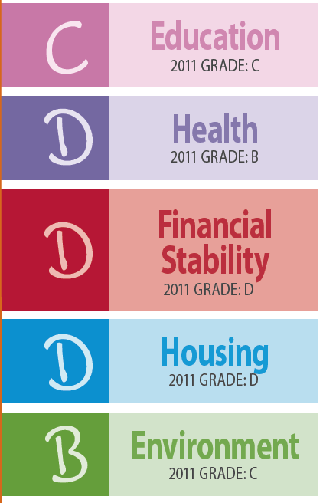
2018 SILICON VALLEY REPORT CARD
‹#›

Slide 23
Voices of Change
Free Download: www.hfsv.org

Slide 24
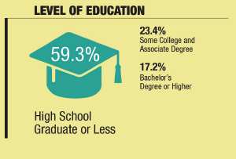
VOICES OF CHANGE
Low Educational Attainment Levels Mirrors Census Data
What is the highest level of education you completed?

Slide 25
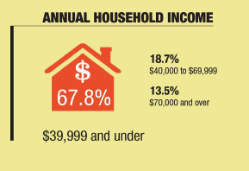
VOICES OF CHANGE
Household Income
Self-Sufficiency Standard
Santa Clara =
$76,319
San Mateo County=
$79,056
Self-Sufficiency standard refers to a household comprised of two adults and 1 infant (0-2 years)
(Source: Insight Center for Community and Economic Development)

Slide 26
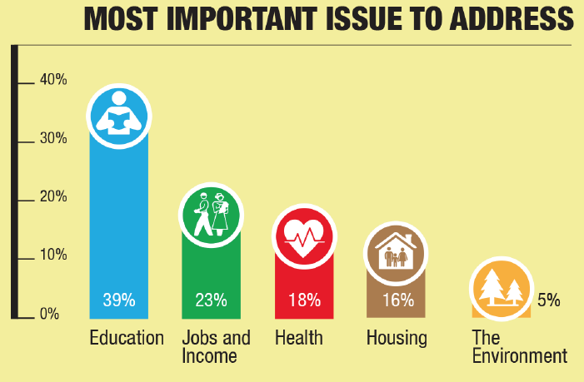
VOICES OF CHANGE

Slide 27
VOICES OF CHANGE
Key Differences by Education Attainment
Higher Levels of Education
Top Issue: Education
More likely to rate quality of life as “very bad”
Overall, higher rates of civic engagement
Lower Levels of Education
Top Issue: Health
More likely to rate quality of life as “OK” to “Excellent”
Approximately 30% have participated in public meetings or volunteer work
89% of all participants had never been asked for their opinion on quality of life issues in the past as in this survey.
‹#›

Slide 28
LATINO REPORT CARD SMALL GROUP
DISCUSSION
What were the top 3 things that surprised you in the 2018 Latino Report Card?
2. Were there issues that you could relate to personally?

